Slide 1
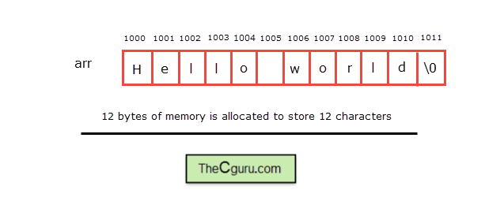
Character Arrays and pointers
Character arrays should be large enough to store a string.

Slide 2
Functions in string.h
String functions | Description
strcat ( ) | Concatenates str2 at the end of str1
strncat ( ) | Appends a portion of string to another
strcpy ( ) | Copies str2 into str1
strncpy ( ) | Copies given number of characters of one string to another
strlen ( ) | Gives the length of str1
strcmp ( ) | Returns 0 if str1 is same as str2. Returns <0 if strl < str2. Returns >0 if str1 > str2
strcmpi ( ) | Same as strcmp() function. But, this function negotiates case. “A” and “a” are treated as same.
strchr ( ) | Returns pointer to first occurrence of char in str1
strrchr ( ) | last occurrence of given character in a string is found
strstr ( ) | Returns pointer to first occurrence of str2 in str1
strrstr ( ) | Returns pointer to last occurrence of str2 in str1
strdup ( ) | Duplicates the string
strlwr ( ) | Converts string to lowercase
strupr ( ) | Converts string to uppercase
strrev ( ) | Reverses the given string
strset ( ) | Sets all character in a string to given character
strnset ( ) | It sets the portion of characters in a string to given character
strtok ( ) | Tokenizing given string using delimiter
https://www.tutorialspoint.com/c_standard_library/string_h.htm

Slide 3
Character Arrays and pointers
Like we can handle pointers with array, similarly we can use character type pointers for character arrays.
We can also print the array as ptr[2]; l
Ptr[0] = A; //Aello
*ptr=A;
Ptr++…
char arr[] = "Hello"; // array version char *ptr ;// pointer version ptr=arr ;

Slide 4
Dynamic Memory Allocation for Arrays
char* pvalue = NULL; // Pointer initialized with null
pvalue = new char[20];
delete [] pvalue;
double** pvalue = NULL; // Pointer initialized with null
pvalue = new double [3][4];
delete [] pvalue;

Slide 5
MEMORY LEAK & DANGLING POINTERS
A dangling pointer points to memory that has already been freed. The storage is no longer allocated. Trying to access it might cause a Segmentation fault.
int *c = new int();
Delete c;
*c = 3; //writing to freed location!
A memory leak is memory which hasn't been freed, there is no way to access (or free it) now, as there are no ways to get to it anymore. (E.g. a pointer which was the only reference to a memory location dynamically allocated (and not freed) which points somewhere else now.)
void func(){
char *ch = new int(10);
}
//ch not valid outside, no way to access malloc-ed memory

Slide 6
Character Arrays
#include <iostream>
const max_len = 256;
int main()
{
using namespace std;
cout << "Please enter string: ";
char* str = new char[max_len + 1];
for (int i = 0; i < max_len; i++)
{
cin >> str[i];
if (str[i] == '\n')
{
str[i] = '\0';
break;
}
}
cout << "Entered string is:" << str << endl;
delete [] str;
return 0;

Slide 7
Unusual behaviour with character pointers
using namespace std; // Driver Code int main() { // Integer array int a[] = { 1, 2, 3 }; // Character array char ch[] = "abc"; // Print the value of a and b cout << a << endl; cout << ch << endl; return 0; }
Output:
0x7ffc623e56c0
abc

Slide 8
Unusual behaviour with character pointers
#include <iostream>
using namespace std;
// Driver Code
int main()
{
// Character array b
char b[] = "abc";
// Pointer to character array
char* c = &b[0];
// Print the value of c
cout << c << endl;
}
Output:
abc
Explanation:
In this example as well, the character type pointer c is storing the base address of the char array b[] and hence when used with cout, it starts printing each and every character from that base address till it encounters a NULL character.

Slide 9
Dynamic character array
#include <iostream>
#include <cstring>
using namespace std;
int main()
{
char *s1=new char[50];
char *s2=new char[50];
cout << "Enter string s1: ";
cin.getline(s1, 50);
cout << "Enter string s2: ";
cin.getline(s2, 50);
strcat(s1, s2);
cout << "s1 = " << s1 << endl;
cout << "s2 = " << s2;
}

Slide 10
Void Pointer
A void pointer is a pointer that has no associated data type with it. A void pointer can hold address of any type and can be typecasted to any type.
int a = 10;
char b = 'x';
void *p = &a; // void pointer holds address of int 'a'
p = &b; // void pointer holds address of char 'b'

Slide 11
Facts about Void Pointer
void pointers cannot be dereferenced. For example the following program doesn’t compile.
#include<iostream>
using namespace std;
int main()
{
int a = 10;
void *ptr = &a;
cout<< *ptr;
return 0;
}
The following program compiles and runs fine.
#include<iostream>
using namespace std;
int main()
{
int a = 10;
void *ptr = &a;
cout<< *(int *)ptr;
return 0;
}

Slide 12
Pointers to 2D array
In a two dimensional array, we can access each element by using two subscripts, where first subscript represents the row number and second subscript represents the column number.
The elements of 2-D array can be accessed with the help of pointer notation also. Suppose arr is a 2-D array, we can access any element arr[i][j] of the array using the pointer expression *(*(arr + i) + j). Now we’ll see how this expression can be derived.

Slide 13
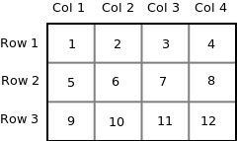
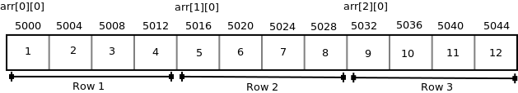
Pointers to 2D array
int arr[3][4] = { {1, 2, 3, 4}, {5, 6, 7, 8}, {9, 10, 11, 12} };
Since memory in a computer is organized linearly it is not possible to store the 2-D array in rows and columns. The concept of rows and columns is only theoretical, actually, a 2-D array is stored in row-major order i.e rows are placed next to each other. The following figure shows how the above 2-D array will be stored in memory.

Slide 14
Pointers to 2D array
Each row can be considered as a 1-D array, so a two-dimensional array can be considered as a collection of one-dimensional arrays that are placed one after another.
So here arr is an array of 3 elements where each element is a 1-D array of 4 integers.

Slide 15
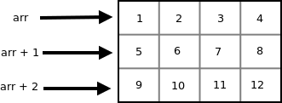

Pointers to 2D array
Since arr is a ‘pointer to an array of 4 integers’, according to pointer arithmetic the expression arr + 1 will represent the address 5016 and expression arr + 2 will represent address 5032.
So we can say that arr points to the 0th 1-D array, arr + 1 points to the 1st 1-D array and arr + 2 points to the 2nd 1-D array.

Slide 16
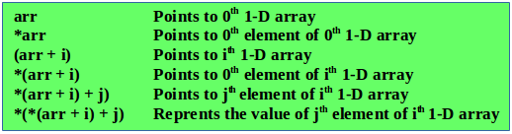
To access an individual element of our 2-D array, we should be able to access any jth element of ith 1-D array.
Since the base type of *(arr + i) is int and it contains the address of 0th element of ith 1-D array, we can get the addresses of subsequent elements in the ith 1-D array by adding integer values to *(arr + i).
For example *(arr + i) + 1 will represent the address of 1st element of 1st element of ith 1-D array and *(arr+i)+2 will represent the address of 2nd element of ith 1-D array.
Similarly *(arr + i) + j will represent the address of jth element of ith 1-D array. On dereferencing this expression we can get the jth element of the ith 1-D array.

Slide 17
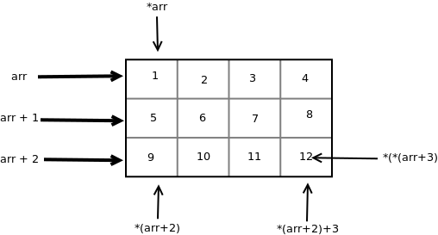
For example *(arr + i) + 1 will represent the address of 1st element of 1st element of ith 1-D array and *(arr+i)+2 will represent the address of 2nd element of ith 1-D array.
Similarly *(arr + i) + j will represent the address of jth element of ith 1-D array. On dereferencing this expression we can get the jth element of the ith 1-D array.

Slide 18
Address of 0th array = 0x7ffe50edd580 0x7ffe50edd580
10 10 11 11 12 12 13 13
Address of 1th array = 0x7ffe50edd590 0x7ffe50edd590
20 20 21 21 22 22 23 23
Address of 2th array = 0x7ffe50edd5a0 0x7ffe50edd5a0
30 30 31 31 32 32 33 33
int main()
{
int arr[3][4] = {
{ 10, 11, 12, 13 },
{ 20, 21, 22, 23 },
{ 30, 31, 32, 33 }
};
int i, j;
for (i = 0; i < 3; i++)
{
cout<< i, arr[i], *(arr + i);
for (j = 0; j < 4; j++)
cout<<arr[i][j]<< *(*(arr + i) + j);
cout<<\n";
}
return 0;

Slide 19
using namespace std;
// Driver Code
int main()
{
// Dimensions of the array
int m = 3, n = 4, c = 0;
// Declare memory block of size M
int** a = new int*[m];
for (int i = 0; i < m; i++) {
// Declare a memory block
// of size n
a[i] = new int[n];
}
// Traverse the 2D array
for (int i = 0; i < m; i++) {
for (int j = 0; j < n; j++) {
// Assign values to the
// memory blocks created
a[i][j] = ++c;
}
}
// Traverse the 2D array
for (int i = 0; i < m; i++) {
for (int j = 0; j < n; j++) {
// Print the values of
// memory blocks created
cout << a[i][j] << " ";
}
cout << endl;
}
//Delete the array created
for(int i=0;i<m;i++) //To delete the inner arrays
delete [] a[i];
delete [] a; //To delete the outer array
//which contained the pointers
//of all the inner arrays
return 0;
}

Slide 20
Accessing ctype string via pointer
int main() {
// string variable
char str[6] = "Hello";
// pointer variable
char *ptr = str;
// print the string
while(*ptr != '\0') {
cout<< *ptr;
// move the ptr pointer to the next memory location
ptr++;
}

Slide 21
Using pointer to store string
int main() {
// pointer variable to store string
char *strPtr = "Hello";
// temporary pointer variable
char *t = strPtr;
// print the string
while(*t != '\0') {
cout<< *t;
// move the t pointer to the next memory location
t++;
}
}

Slide 22
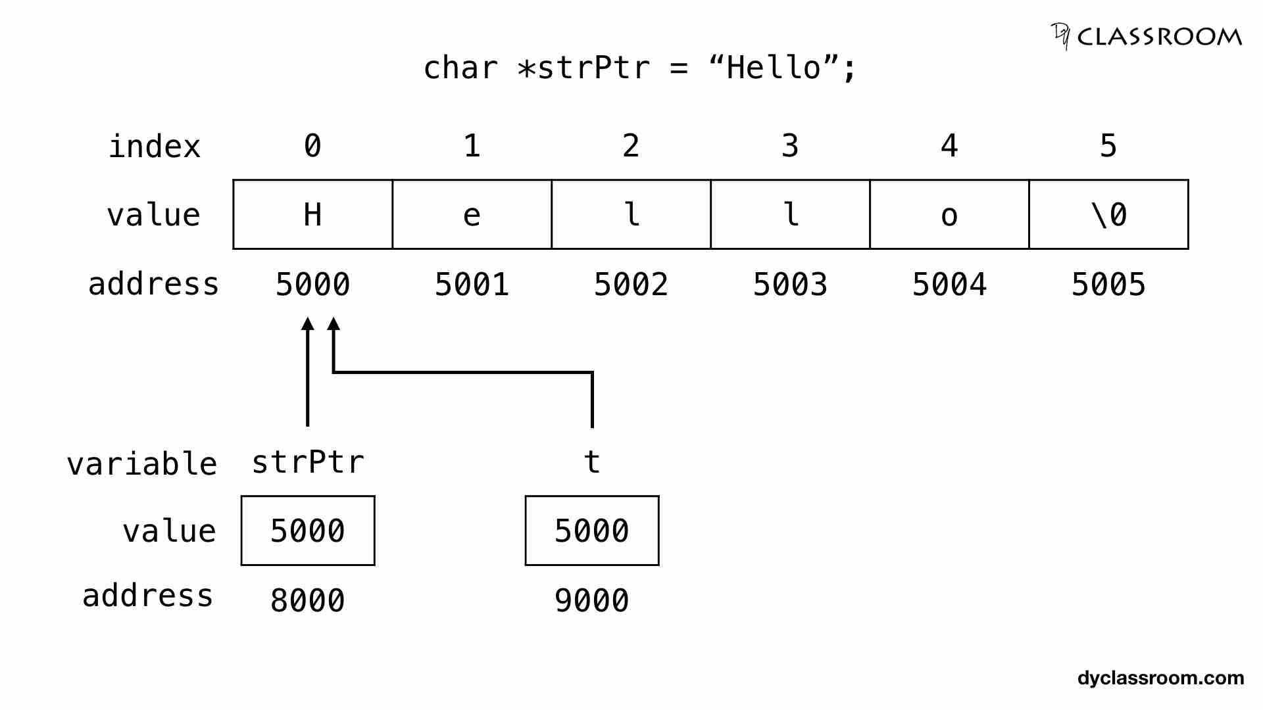

Slide 23
Array of strings
int main() {
char city[4][12] = {
"Chennai",
"Kolkata",
"Mumbai",
"New Delhi"
};
}

Slide 24
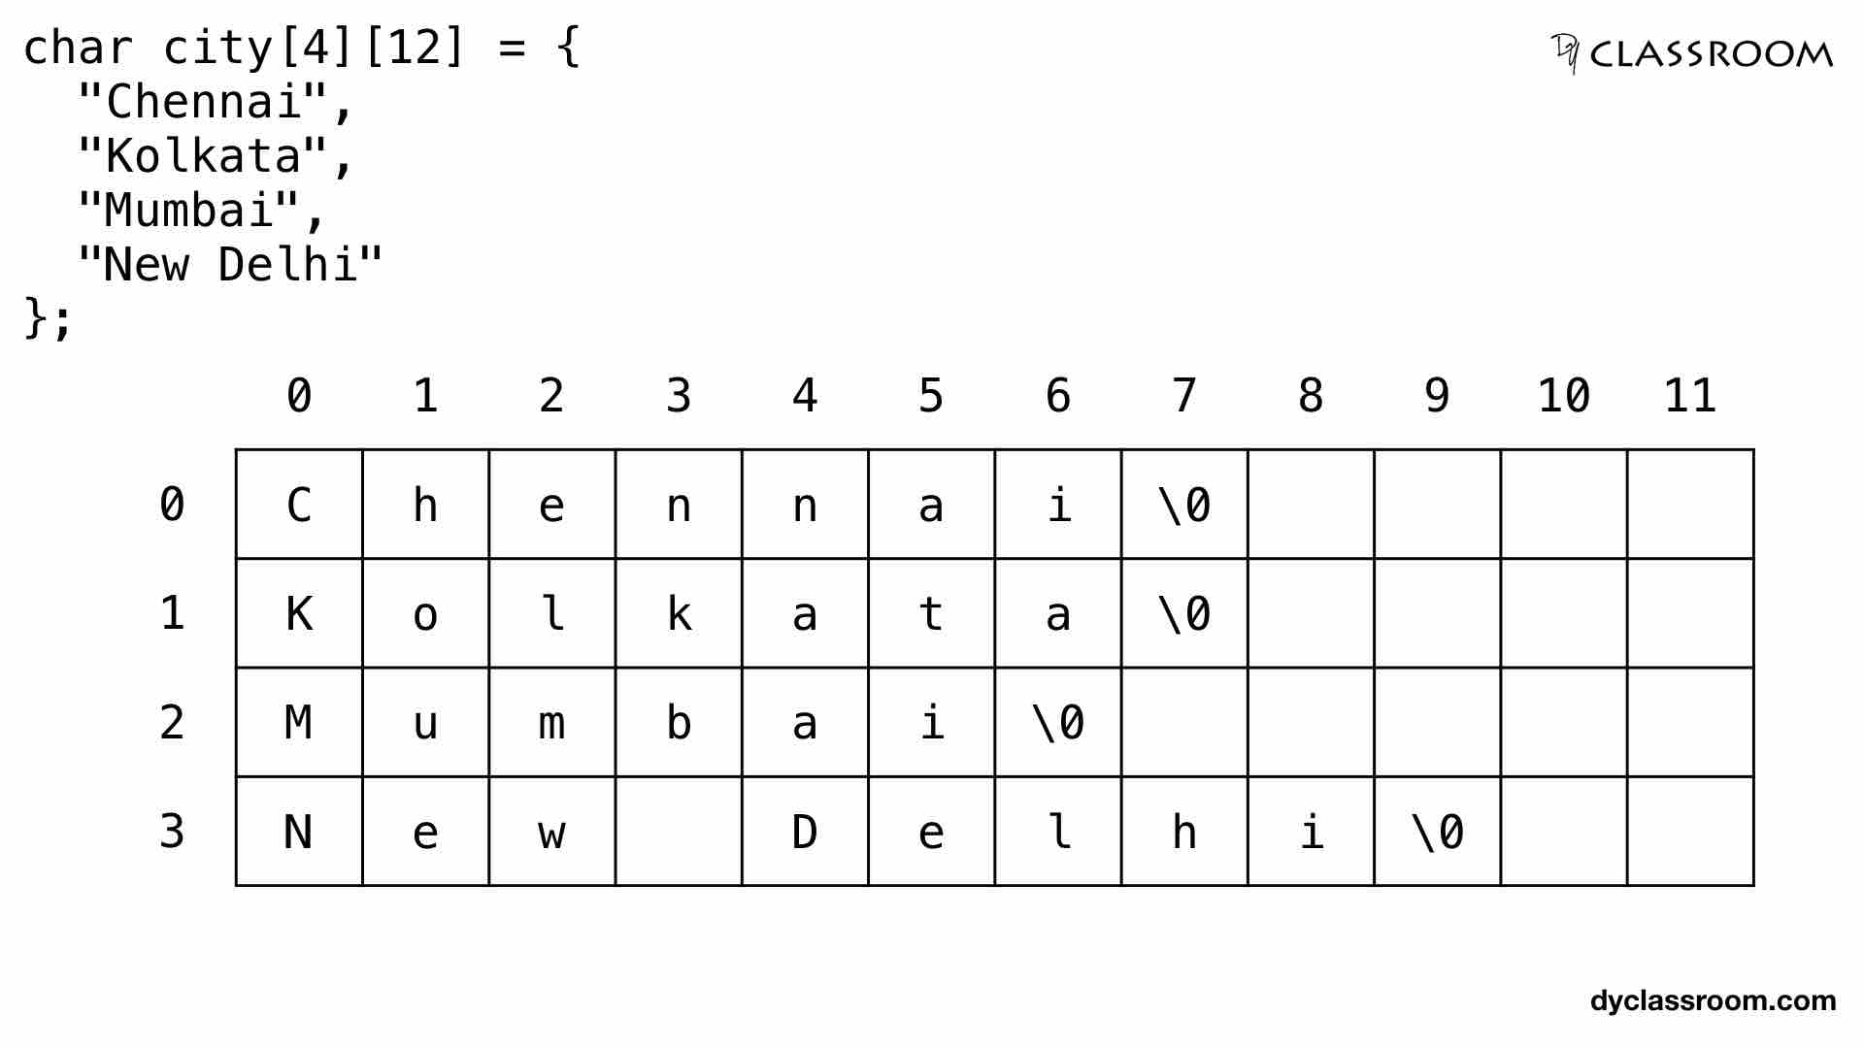

Slide 25
character array
int main() {
char *cityPtr[4] = {
"Chennai",
"Kolkata",
"Mumbai",
"New Delhi"
};
}

Slide 26
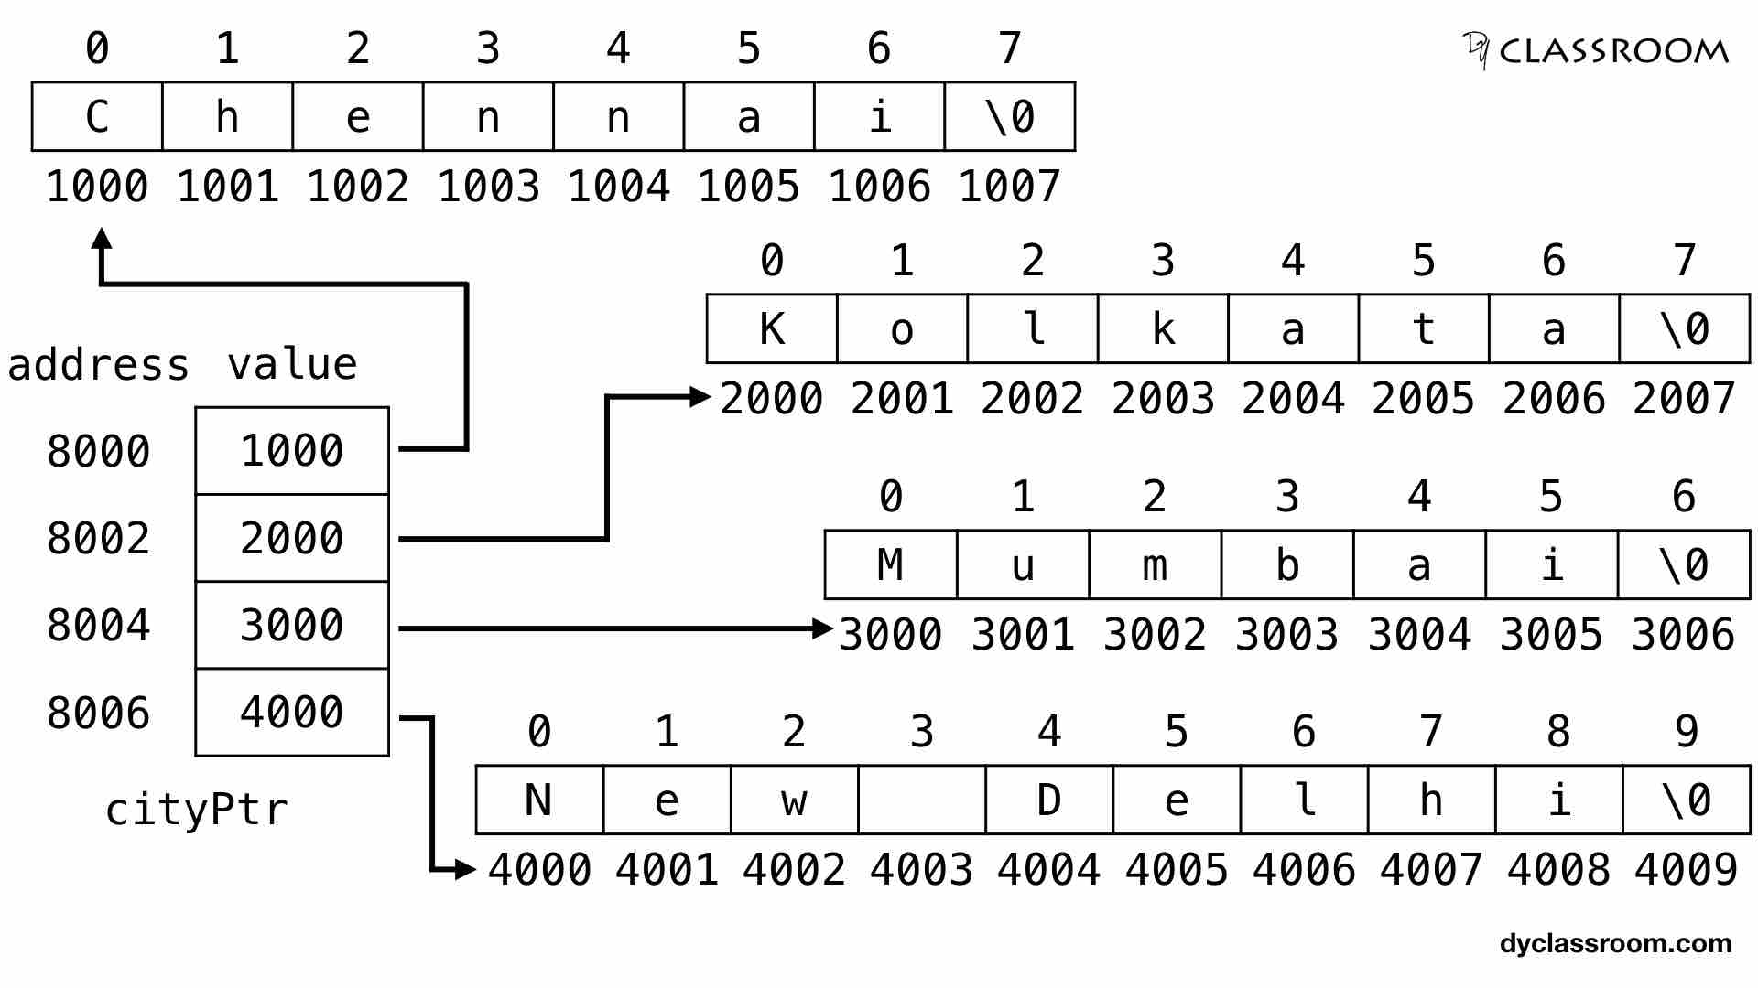

Slide 27
Arrays of Strings
#include <iostream>
using namespace std;
int main()
{
const int DAYS = 7; //number of strings in array
const int MAX = 10; //maximum size of each string
//array of strings
char star[DAYS][MAX] = { “Sunday”, “Monday”, “Tuesday”,
“Wednesday”, “Thursday”,
“Friday”, “Saturday” };
for(int j=0; j<DAYS; j++) //display every string
cout << star[j] << endl;
return 0;
}

Slide 28
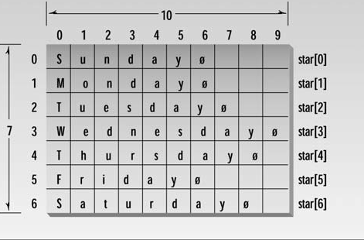
Arrays of Strings

